Slide 1

VOICE ASSISTANT FOR LINUX
Seamless Linux Interaction: Speak, Simplify, Succeed
TEAM MEMBERS
PROJECT GUIDE
B.Rahul (B182362)
M.Surender
Assistant Professor
Ch.Rohith (B181886)
P.Vijay Kumar (B182550)

Slide 2

AGENDA
1
Problem Statement
5
Technologies Used
2
Proposed System
6
Implemented Features
3
Flow Diagram
7
Output
4
Requirements Specifications
8
References

Slide 3





Existing System
Siri for iOS
Alexa for android & IOT
Bixby for Samsung
Copilot for Windows

Slide 4
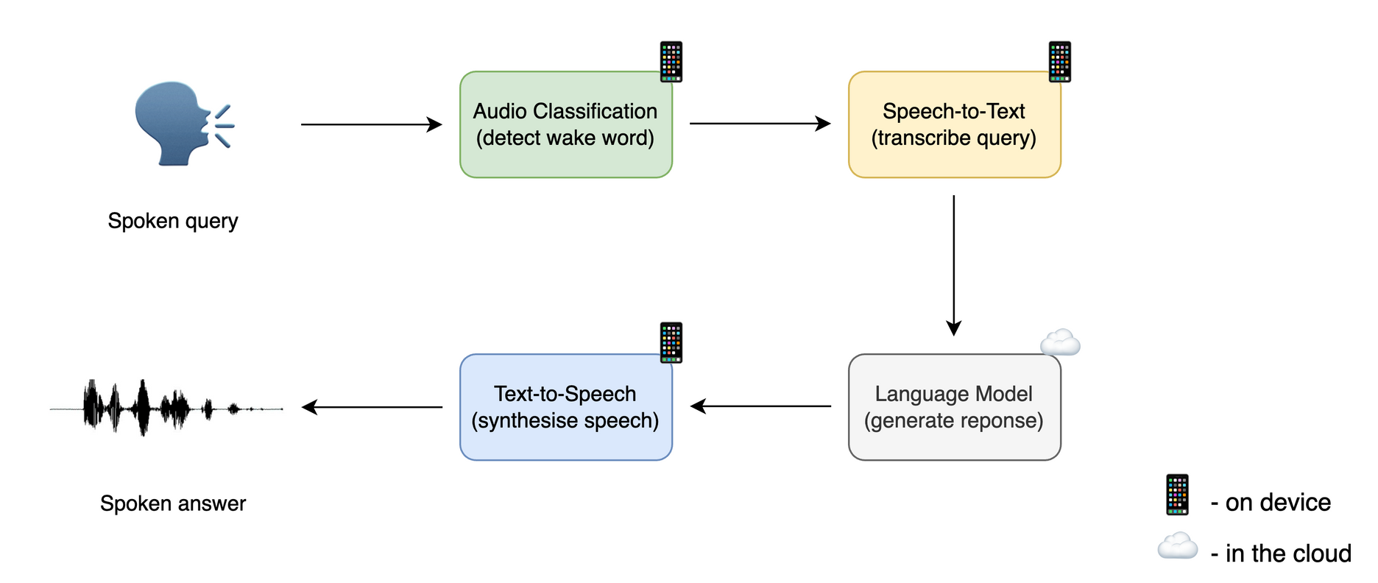
Proposed System

Slide 5
FLOW DIAGRAM
Voice Assistant
Commands
+Queries
Sends Request
U
AUDIO
S
E
+Interpreted to
R
Receive Rsponse
Response
+Receives

Slide 6


SYSTEM REQUIREMENT SPECIFICATIONS
Linux OS
Minimum of 4GB RAM
i5 or AMD Ryzen Processor
256GB SSD
In-built or external Mic

Slide 7




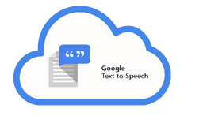
TECHNOLOGIES USED
Speech Recognition
Converts spoken language into text.
Natural Language Understanding (NLU)
To interpret the meaning of user inputs
Natural Language Generation(NLG)
To interpret the meaning of user inputs
Text to Speech
Produces speech output

Slide 8
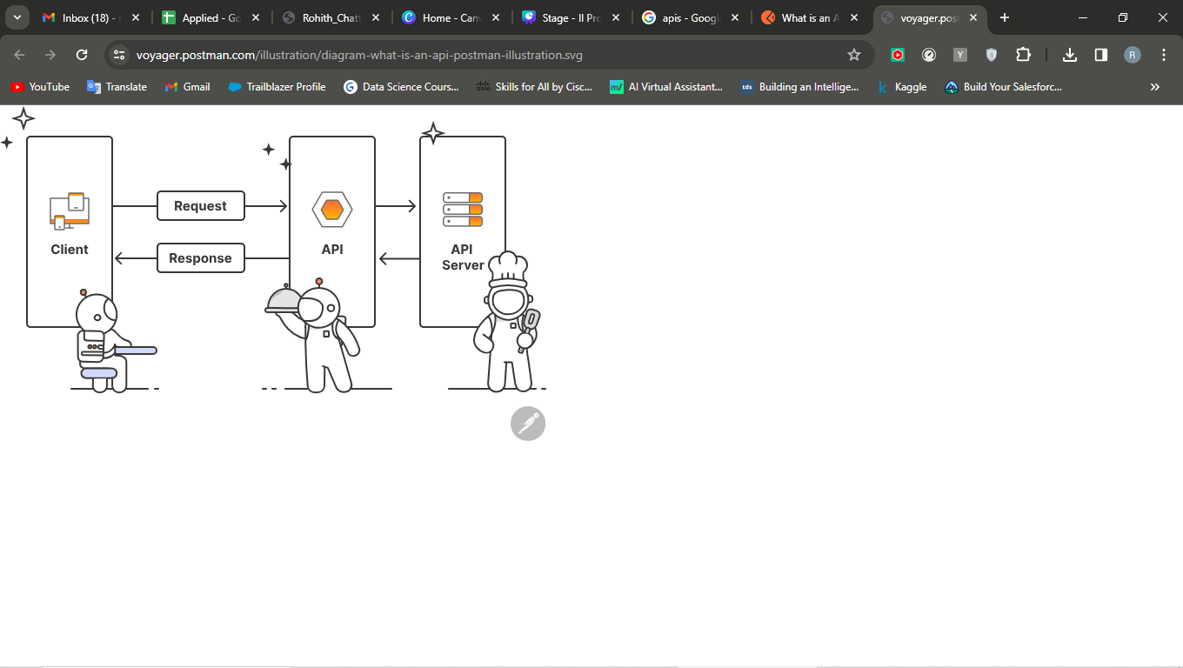
Integrated APIs
OpenWeatherMap
Wolframaplha API
News API
GPT4ALL

Slide 9

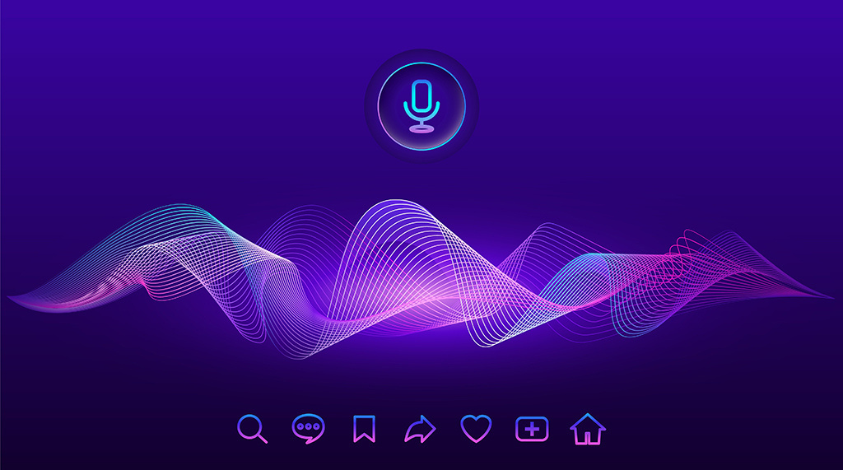
FEATURES IMPLEMENTED
Accessing applications & websites
Performing a google search & wikipedia
Playing songs & videos (Either online or offline)
Bringing smile to your face with its ability to tell a joke
Taking screenshot
Browser operations like opening & closing windows or tabs
Volume , Wi-Fi , Bluetooth and system control actions like sleep & shutdown
Taking notes

Slide 10

Features Implemented using APIS
OpenWeatherMap API : Provides current weather report
WolframAplha API : Obtains qiuck & short results for questions
News API : Latest news headlines according to users’ interest
GPT4ALL : Integrating with open source LLM in our voice assistant

Slide 11
OUTPUT

Slide 12
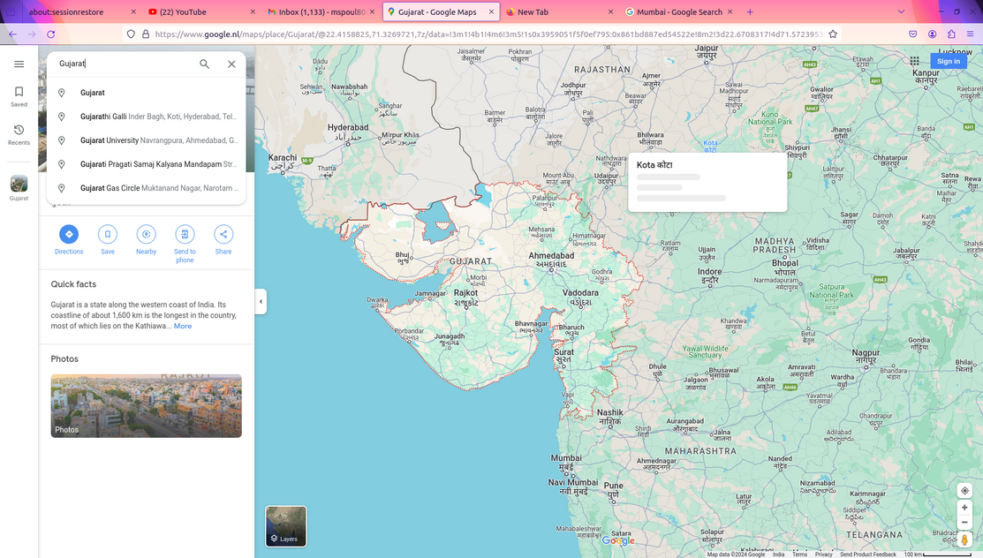
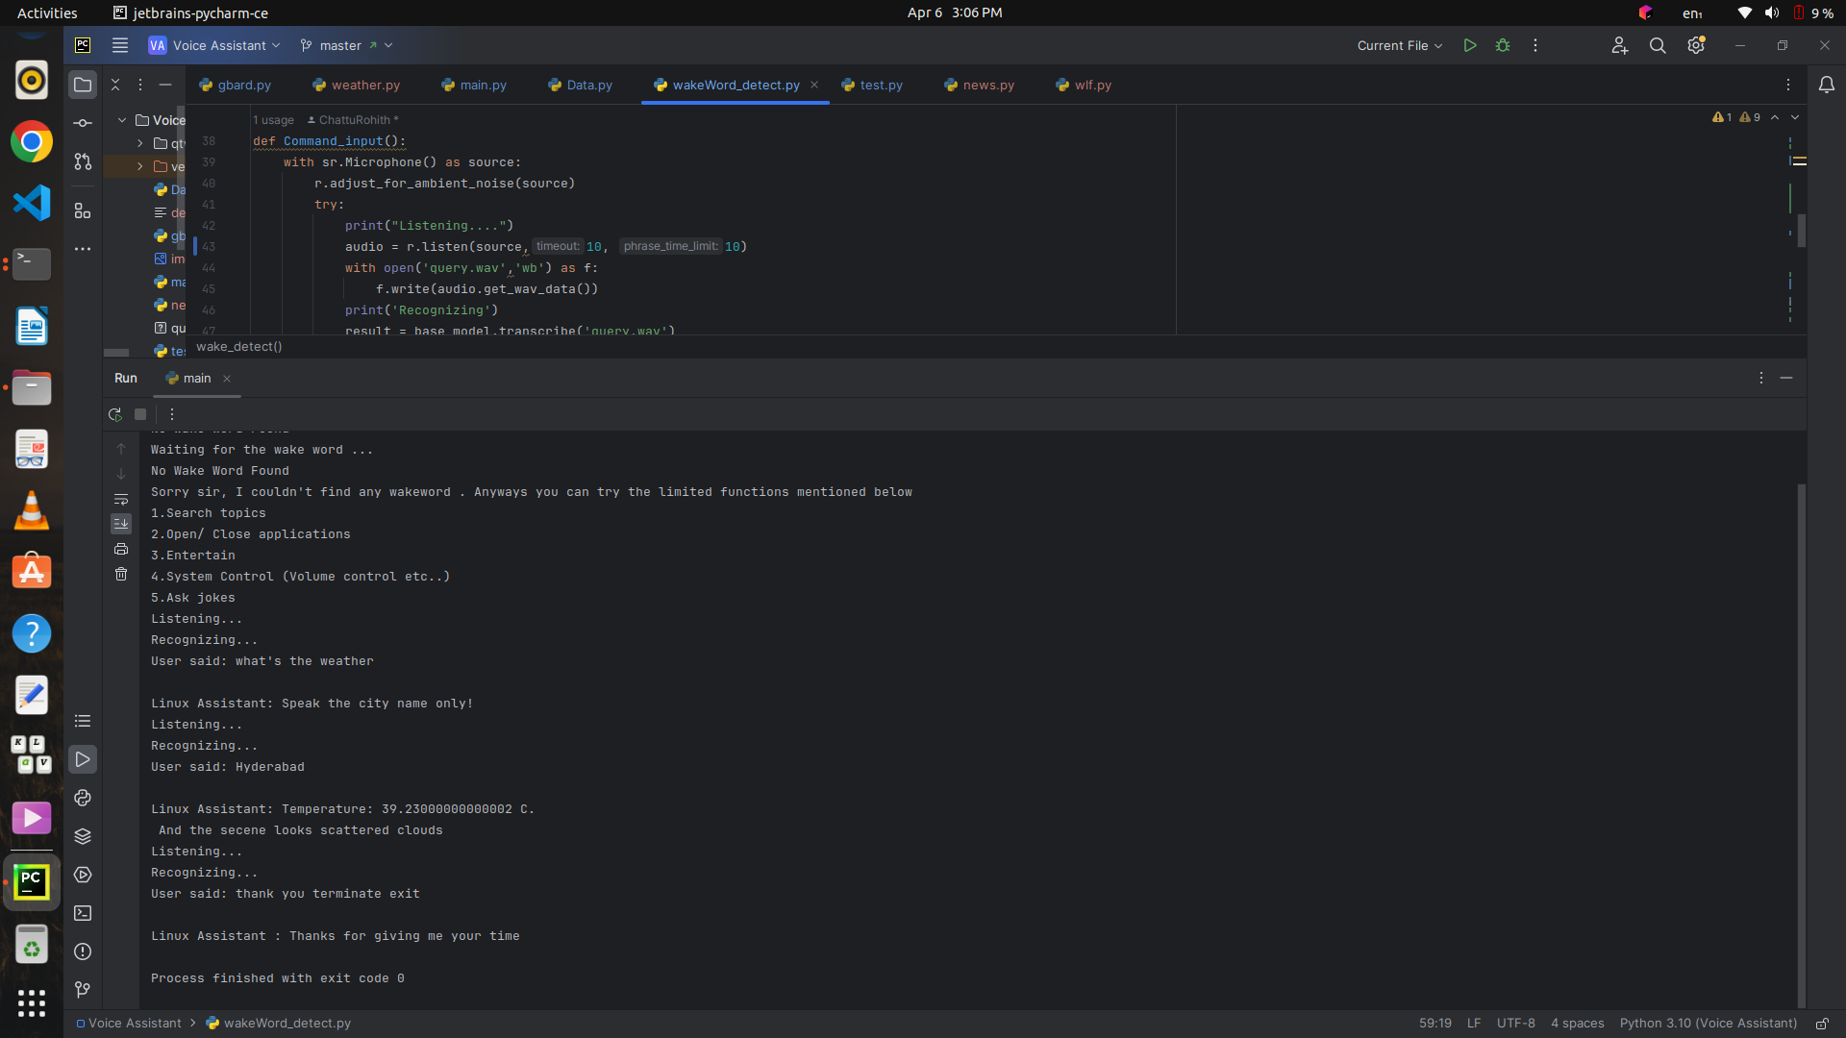
Weather API Output

Slide 13
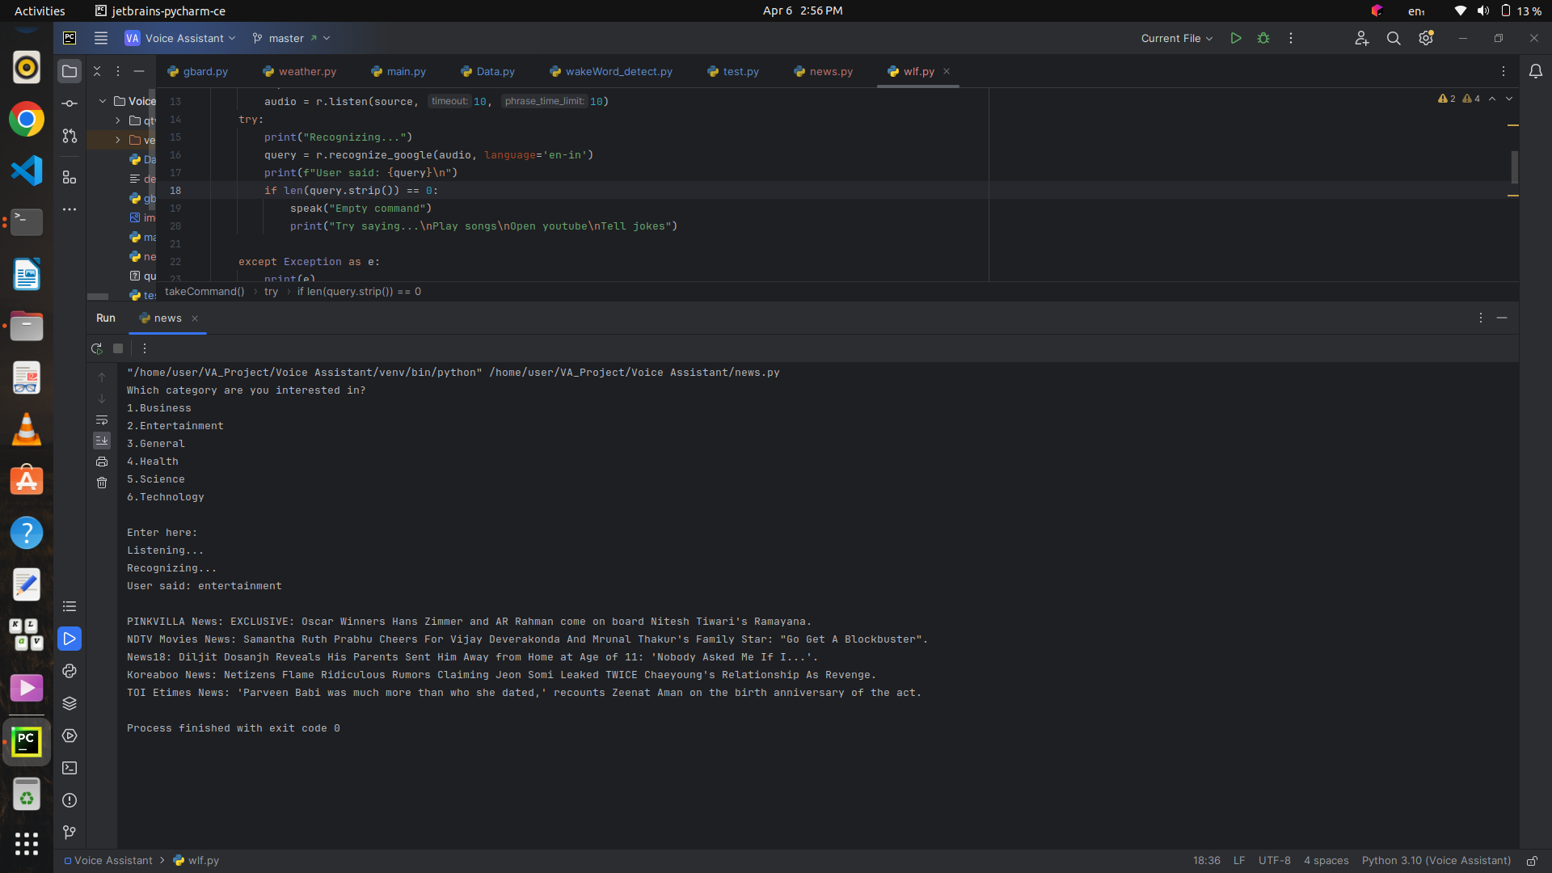
Top 5 News Headlines output

Slide 14
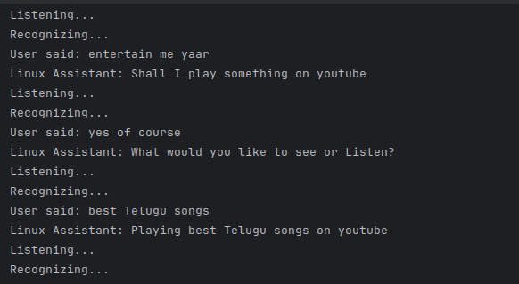
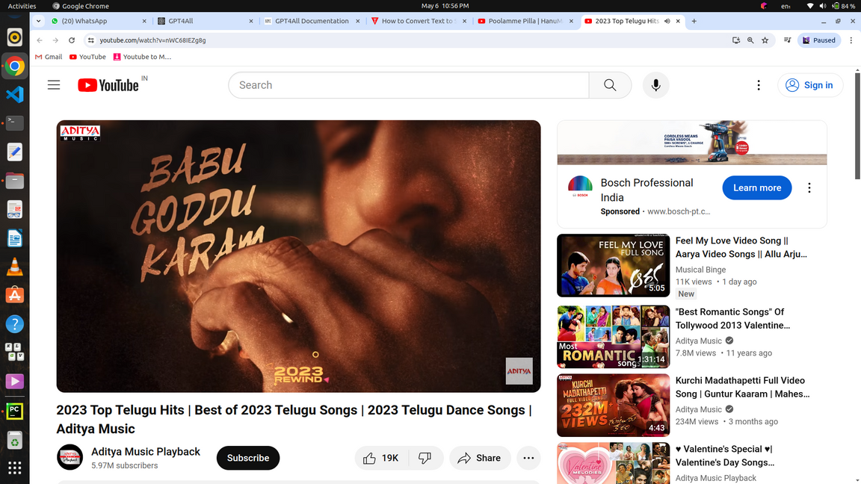


For Entertaining the User
User be like

Slide 15
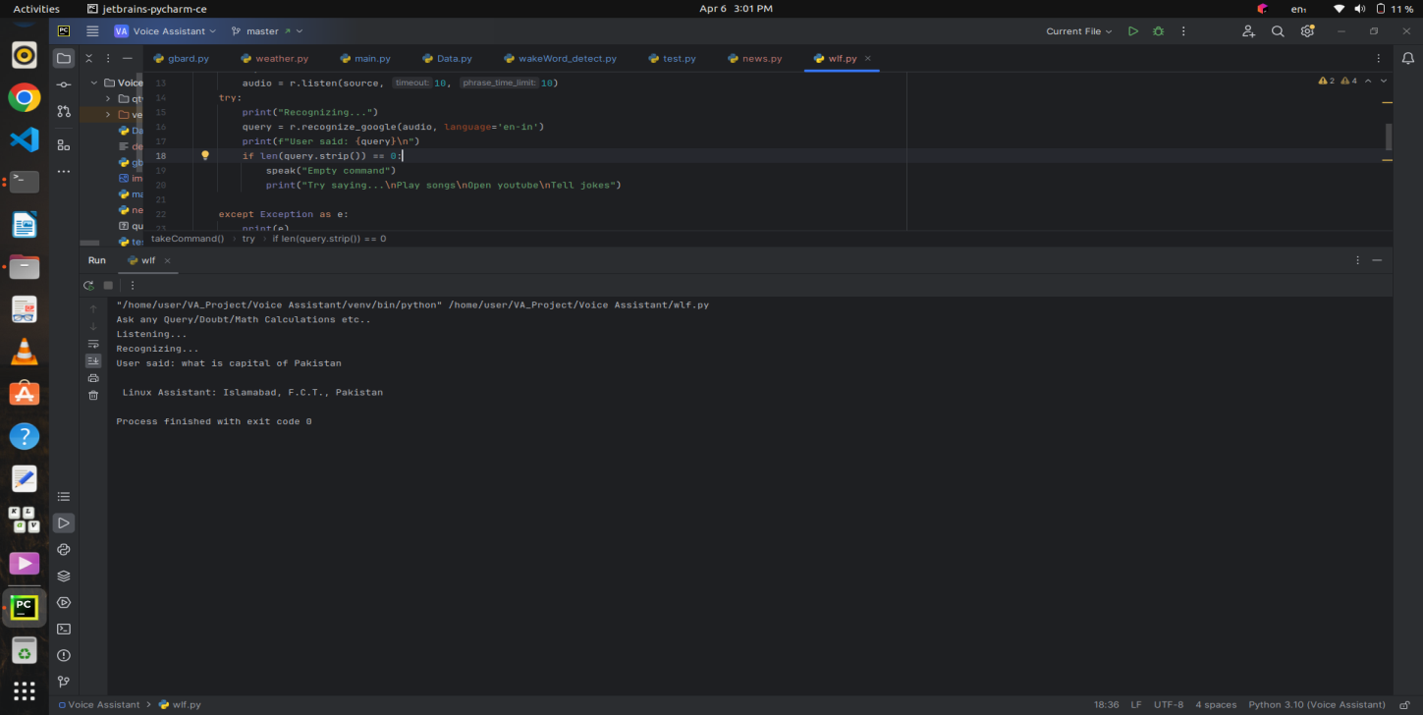
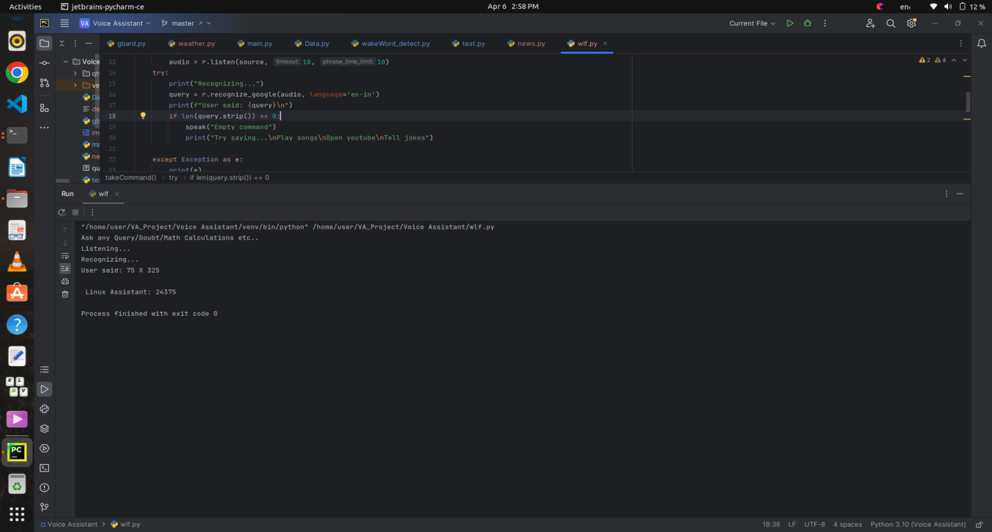
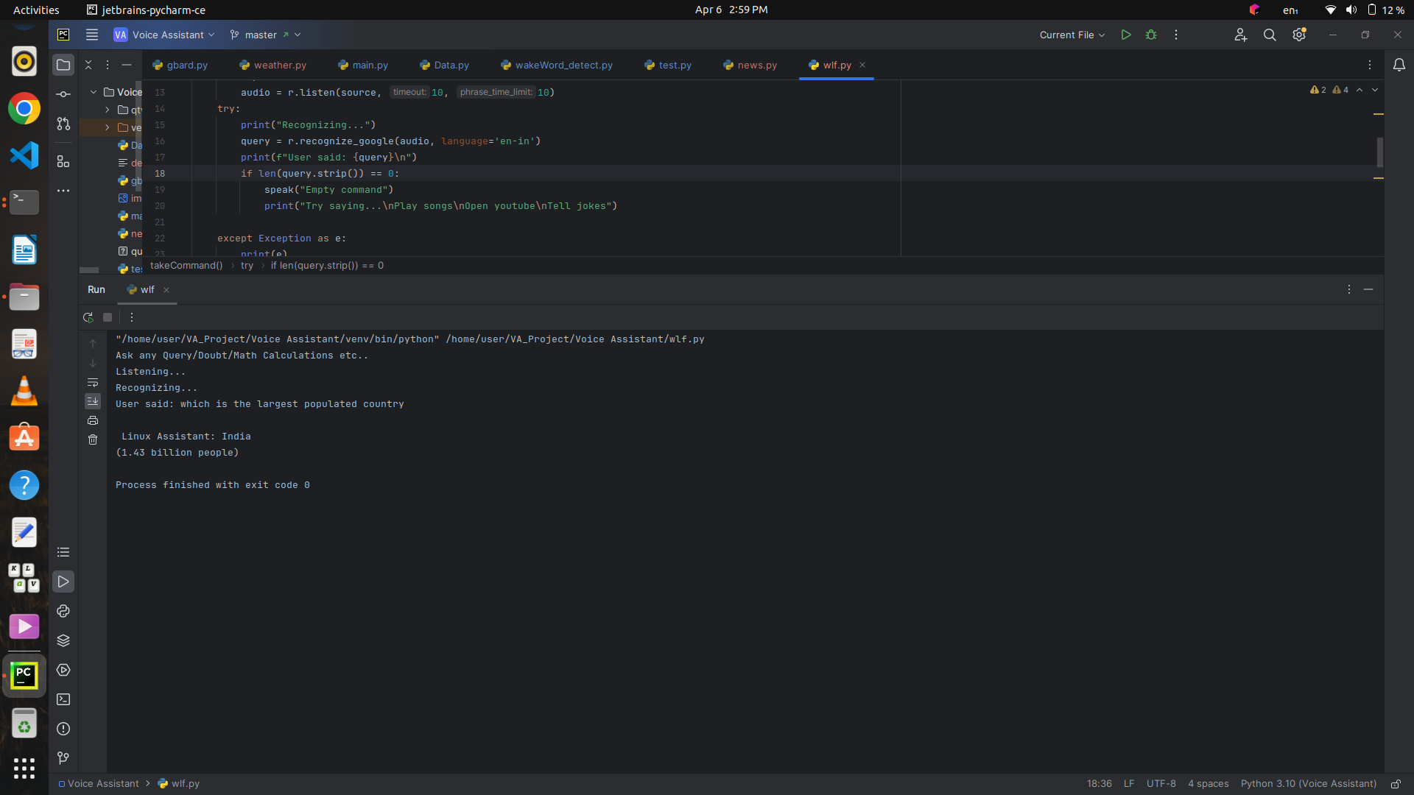
WolframAlpha’s Outputs

Slide 16
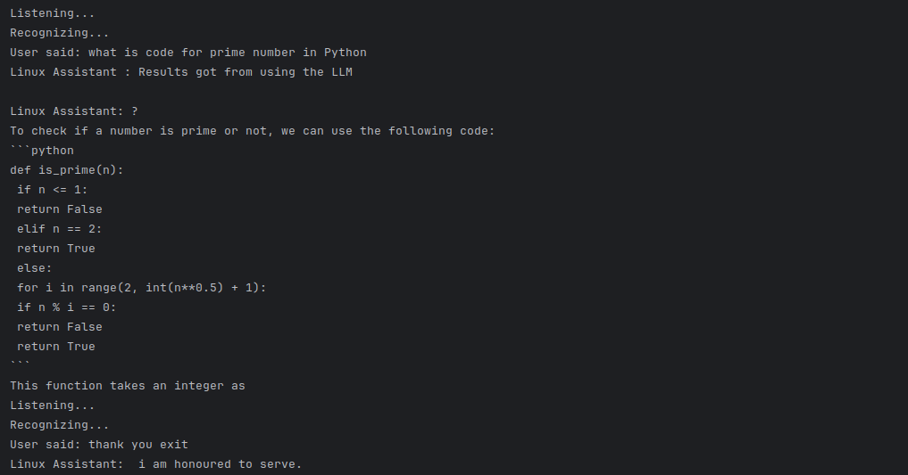
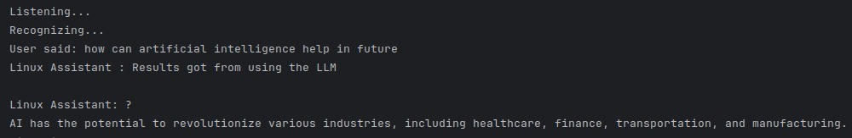
Outputs of
Open Source LLM

Slide 17
References
AI-virtual-assistant-technology-guide
https://medcraveonline.com/IRATJ/IRATJ-08-00240.pdf
Samson. 7 steps to Converting Speech To Text with Python.
Intelligent Personal Assistant Architecture

Slide 18
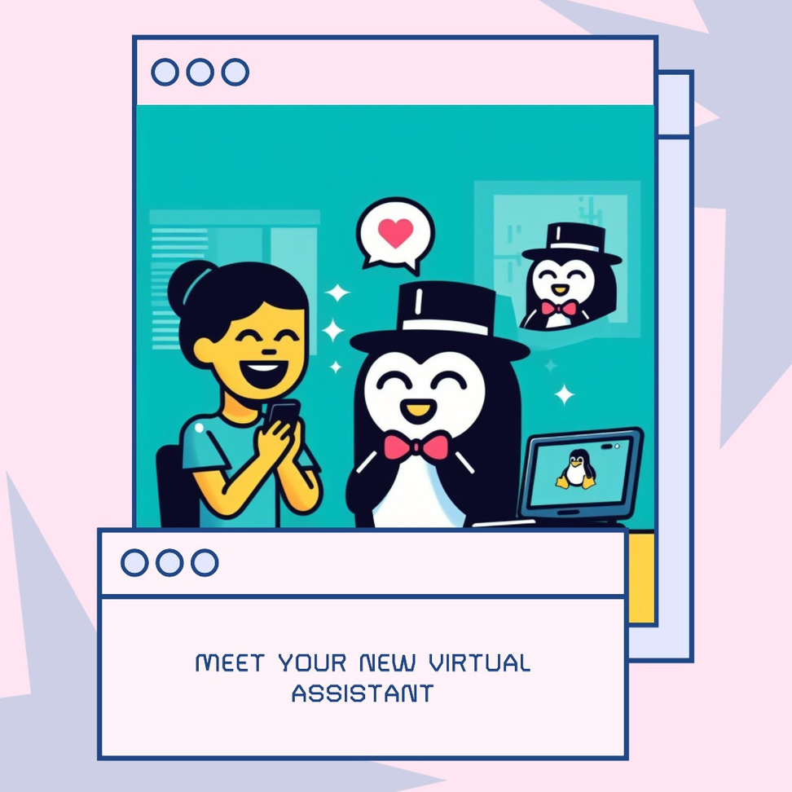
Linux OS is now happier than ever!

Slide 19

THANK YOU

